Slide 1



Private Client-Side Profiling with Random Forests and Hidden Markov Models
George Danezis¹, Markulf Kohlweiss¹, Ben Livshits¹, and Alfredo Rial²
¹Microsoft Research
²KU Leuven ESAT/COSIC – IBBT, Belgium
PETS 2012

Slide 2

Index
Introduction
System Overview
Applications
Random Forests
Our Protocol
Conclusion
http://www.dmrdirect.com/direct-mail/customer-profiling/gain-valuable-marketing-intelligence/

Slide 3
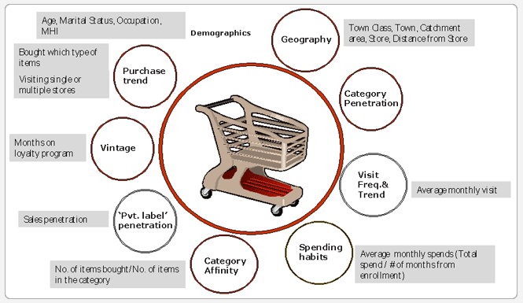
1 – Introduction
http://blog.maia-intelligence.com/2009/10/05/customer-analytics-in-retail/

Slide 4

Current Client Profiling Tools
Client Profiling -> Deliver Customized Services
Current techniques:
  Cookies
  Third party apps in social networks
  Web bugs
Disadvantages
  Privacy
  Correctness
    Ad-hoc
    Block
http://www.pc-xp.com/2010/12/04/web-bug-reveals-internet-browsing-history/

Slide 5
Private Client-Side Profiling
User’s perform the classification task:
  Input certified features and certified algorithm
  Run algorithm:
    Classification: Random Forest
    Pattern Recognition: Hidden Markov Model
  Output result and proof of correctness
  Service provider verifies result
Advantages
  Privacy: Only classification result is disclosed
  Correctness guaranteed by proof

Slide 6
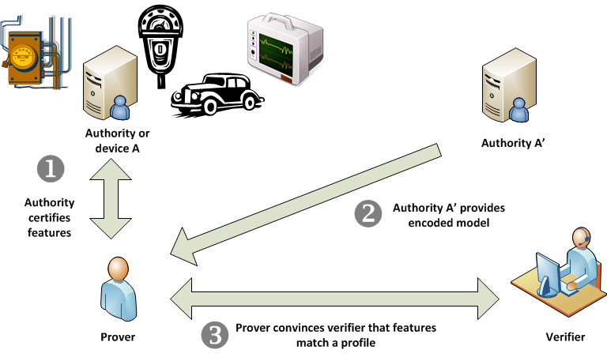
2- System Overview

Slide 7
3- Applications
  Behavioral advertising
  P2P dating & matchmaking
  Financial logs
  Pay-as-you-drive Insurance
  Bio-medical & genetic

Slide 8
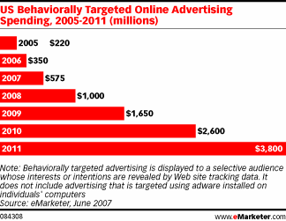
Behavioural Advertising
http://kickstand.typepad.com/metamuse/2008/05/behavioral-adve.html

Slide 9

P2P Dating & Matchmaking
http://www.robhelsby.com/P2P%20Dating.html

Slide 10

Financial logs
http://www.ikeepsafe.org/privacy/arm-yourself-against-online-fraud/

Slide 11
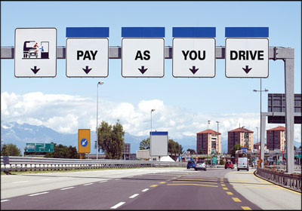
Pay-as-you-drive Insurance
http://www.fenderbender.com/FenderBender/April-2011/Pay-As-You-Drive-Insurance/

Slide 12

Bio-medical & Genetic
http://www.pattern-expert.com/Bioinformatics/eng/bioinformatics/SNPAnalysis.html

Slide 13
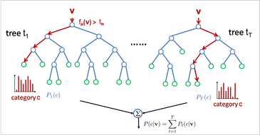
4- Random Forests
http://www.iis.ee.ic.ac.uk/~tkkim/iccv09_tutorial.html

Slide 14
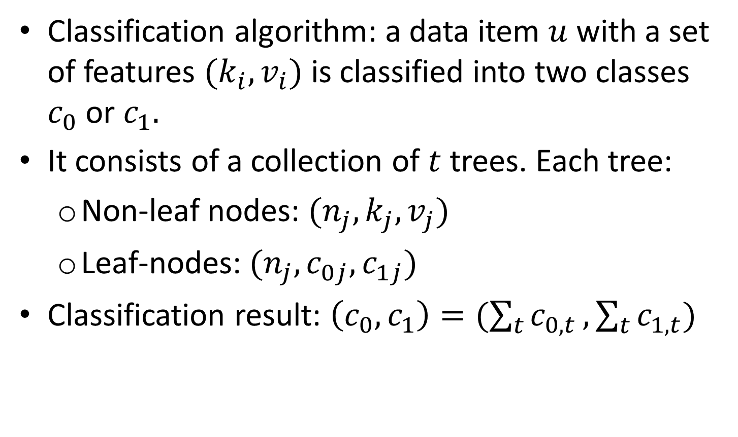
Definition of Random Forest
Classification algorithm: a data item $u$ with a set of features $(k_{i},v_{i})$ is classified into two classes $c_{0}$ or $c_{1}.$
It consists of a collection of $t$ trees. Each tree:
  Non-leaf nodes: $(n_{j},k_{j},v_{j})$
  Leaf-nodes: $(n_{j},c_{0j},c_{1j})$
Classification result: $\left(c_{0},c_{1}\right)=(\sum_{t}{c_{0,t}},\sum_{t}{c_{1,t}})$

Slide 15
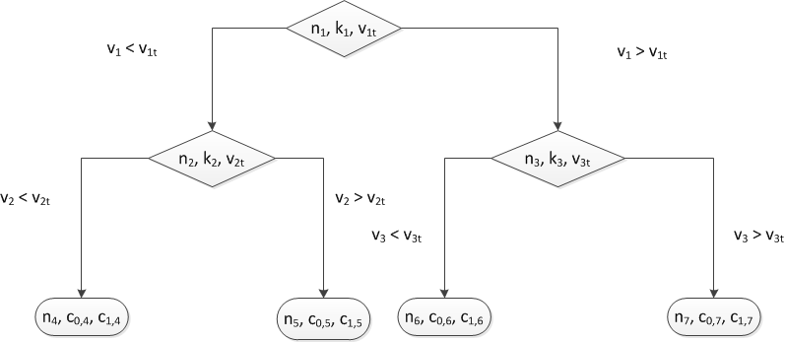
Tree Example

Slide 16
5- Our Protocol
Zero-Knowledge Proofs of Knowledge
P-Signatures: signature schemes with an efficient ZKPK of signature possession

Slide 17
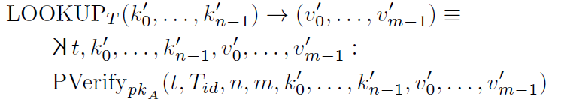

Notation
LOOKUP
ZKTABLE

Slide 18

Phase 1
A sends Prover his certified features:

Slide 19



Phase 2
A’ sends Prover a certified random forest:
Branches:
  Left Branches:
  Right Branches:
Leaf nodes:

Slide 20
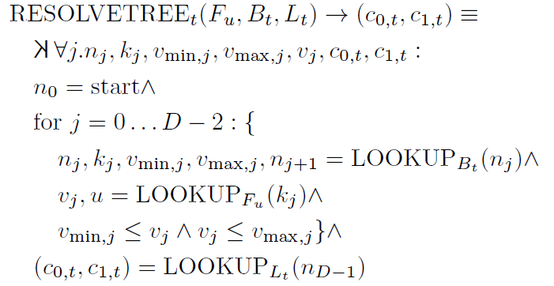
Phase 3 – Tree Resolution
Prover computes the following ZKPK:

Slide 21
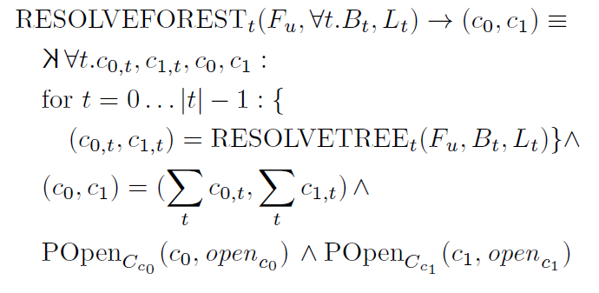
Phase 3 – Forest Resolution
Prover repeats tree resolution for all the trees

Slide 22
Instantiation
P-signature scheme by Au et al. [SCN 2006]
Hidden range proof based on Camenisch et al. [Asiacrypt 2008]
Random forest parameters:
  Number of trees: t = 50
  Depth: D = 10
  Number of features: M = 100
  Average number of feature values: K = 100

Slide 23
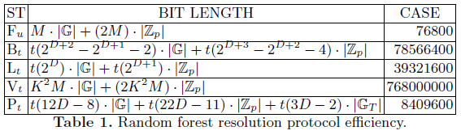
Efficiency
F_{u} = Table of certified user features
B_{t} = Table of branches of all trees
L_{t} = Table of leaf nodes of all trees
V_{t} = Table of signatures for the hidden range proof
P_{t} = Proof of random forest resolution

Slide 24
Conclusion
Private Client-Side Profiling:
  Classification: Random Forests
  Pattern Recognition: Hidden Markov Models
The mere act of profiling may violate privacy.
“We do not see the power which is in speech because
we forget that all speech is a classification, and that
All classifications are oppressive”
Roland Barthes

Slide 25

Comparison Shopping
http://article.wn.com/view/2012/04/19/Life_insurance_cos_new_biz_premiums_down_92/

